Slide 1
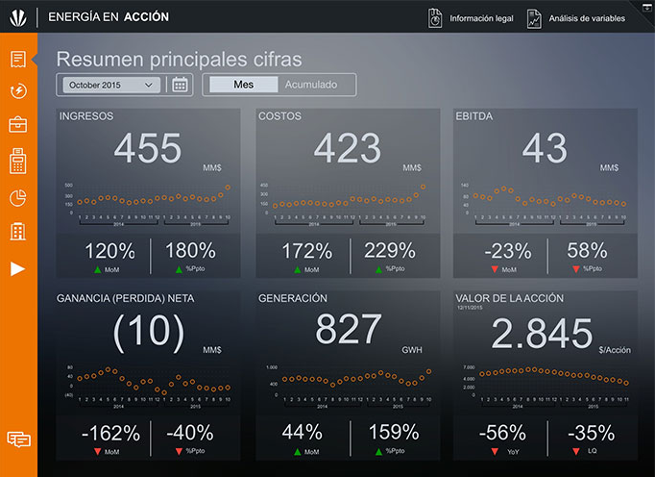

Slide 2
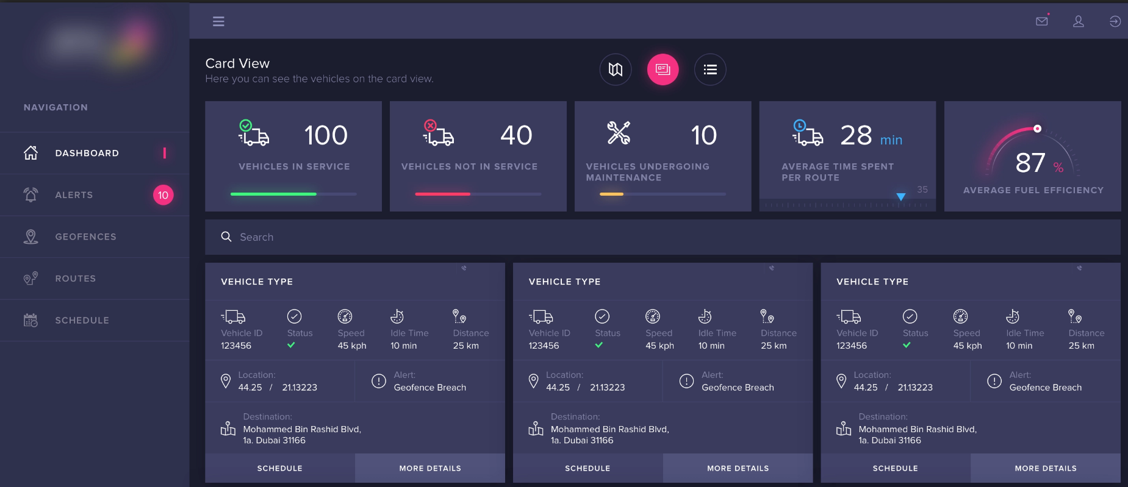
69,251,131
255,65,107
255,195,93
65,180,253
172,146,213

Slide 3
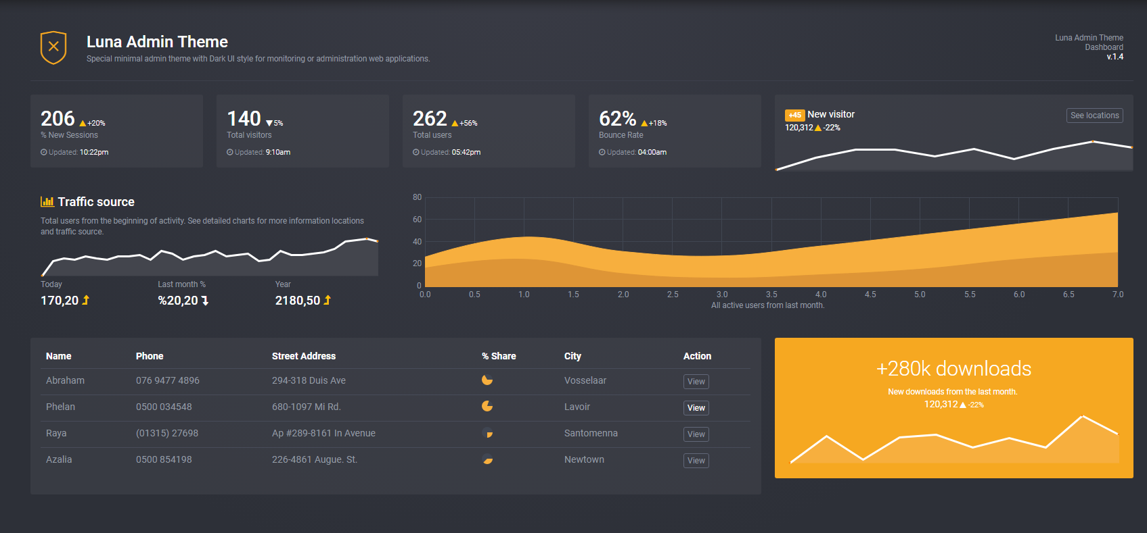
55, 57, 67
55, 57, 67
247, 175, 62

Slide 4
69,251,131
255,65,107
255,195,93
65,180,253
172,146,213

Slide 5
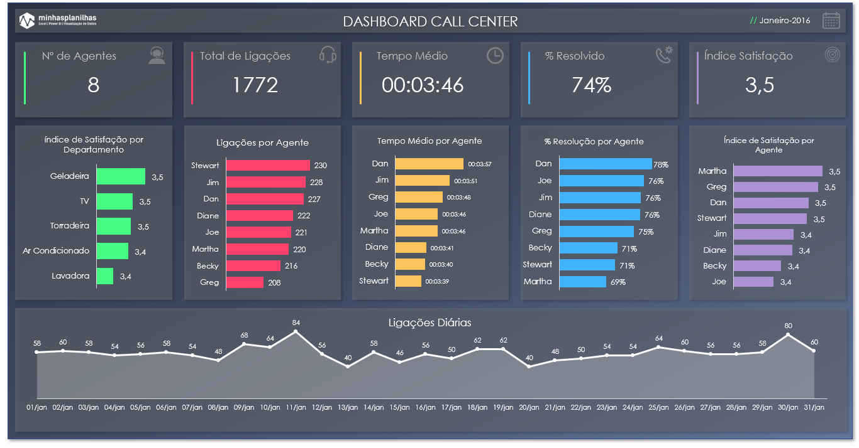

Slide 6

DASHBOARD CALL CENTER

